Slide 1
Wine Quality Prediction
Group Project – Data Mining (ISM 6136) Fall 2022
Anirudh Voruganti
Bharathi Pemmasani
Sravan Kumar Talishetti
Sri Guru Achuth Gadicherla

Slide 2

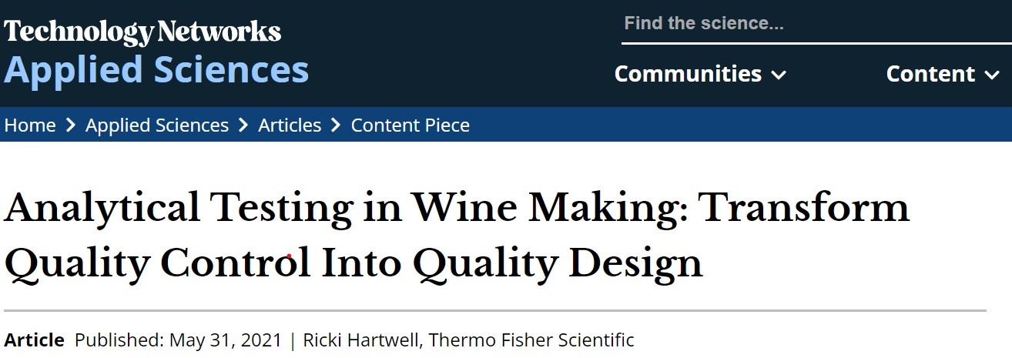
Analytical Testing in Wine Making
Quality control has always played a pivotal role in wine production.
With direct access to data on critical biochemical parameters of production, vintners can rely on more than experience and lessons learned to maneuver the winemaking process.

Slide 3
Business Questions
How can an entrepreneur assess whether their firm is producing quality wine?
Can predictive modeling help in standardizing quality control measures at wineries?
Who Would Care?
Consumers
Regularity authorities
Vintners

Slide 4
Approach to Address Business Questions
Dataset Details
Quality of wine based on critical biochemical parameters
Two Types of Wines (Red & White)
6 thousand records (approx.)
Variables of Interest

Slide 5
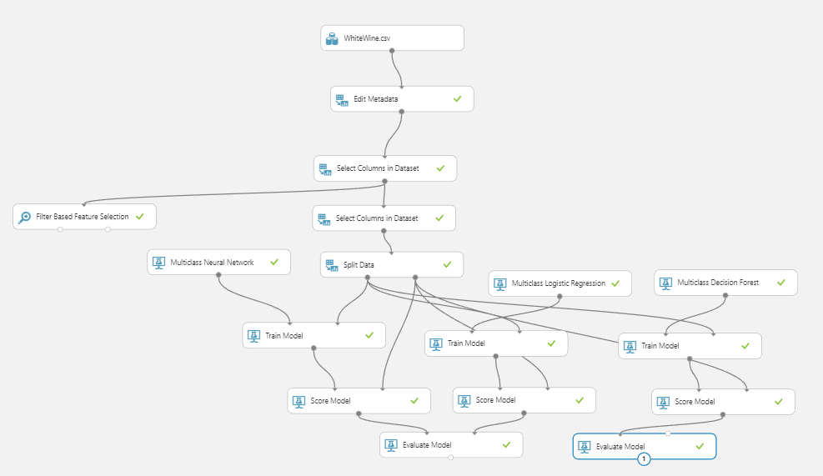
Model Selection & Method

Slide 6
Results

Slide 7
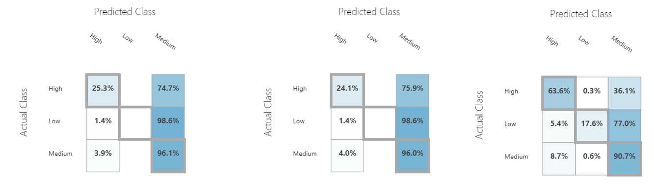
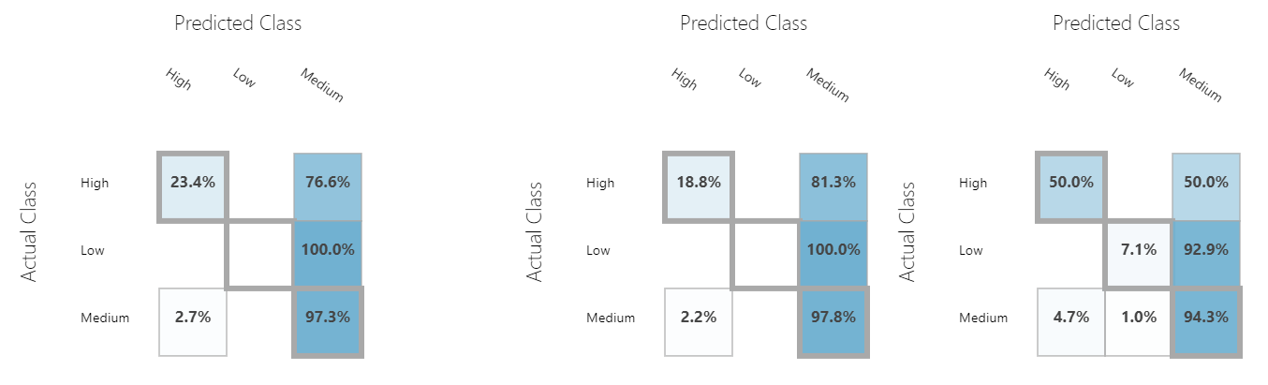
Confusion Matrix for White Wine, Neural Network (L) Logistic Regression (Cen) Decision Forest (R)
Confusion Matrix for Red Wine, Neural Network (L) Logistic Regression (Cen) Decision Forest (R)

Slide 8
Takeaways for Management
From our analysis, we observed that multiclass decision forest, an ensemble model provided the highest accuracy for both data sets.
For our business case, we recommend implementing a predictive modeling system using multiclass decision forests to standardize quality control measures at wineries.
Future Scope
We would like to collect more data samples or perhaps include live and proprietary data to train the model to get better results.
Since we have a class imbalance in the quality variable, we planned to implement oversampling methods such as SMOTE to solve the imbalance problem.

Slide 9
Thank You!

